Slide 1

CUSTOMER CHURN
ANALYSIS & BUSINESS INSIGHTS
Saving the Processed Data for Customer Churn Study and Insights using SQL, Python (EDA), Power BI & Excel

Slide 2

PROJECT OVERVIEW & GOALS
Business context: Customer churn is costly, retaining customers is more profitable than acquiring new ones.
Goal: Identify churn drivers, understand customer behavior, and propose data-driven retention strategies.
Approach: Multi-tool pipeline from raw data → visualization → insights.

Slide 3

Tech & Tools Used
Excel → Data Cleaning, preprocessing.
MySQL → Business queries & structured insights.
Python (Jupyter Notebook) → Deep Exploratory Data Analysis (EDA), visualizations.
Power BI → Interactive dashboards for stakeholders.

Slide 4


Data Cleaning
For this project we used total 3 datasets (Churn Data, Customer Data and Internet Data).
We used Excel for data preprocessing process.
Removed duplicates, missing values, formatting issues.
Standardized categorical variables (e.g., Yes/No, contract types).
Ensured numeric fields (charges, tenure) were clean for modeling.

Slide 5
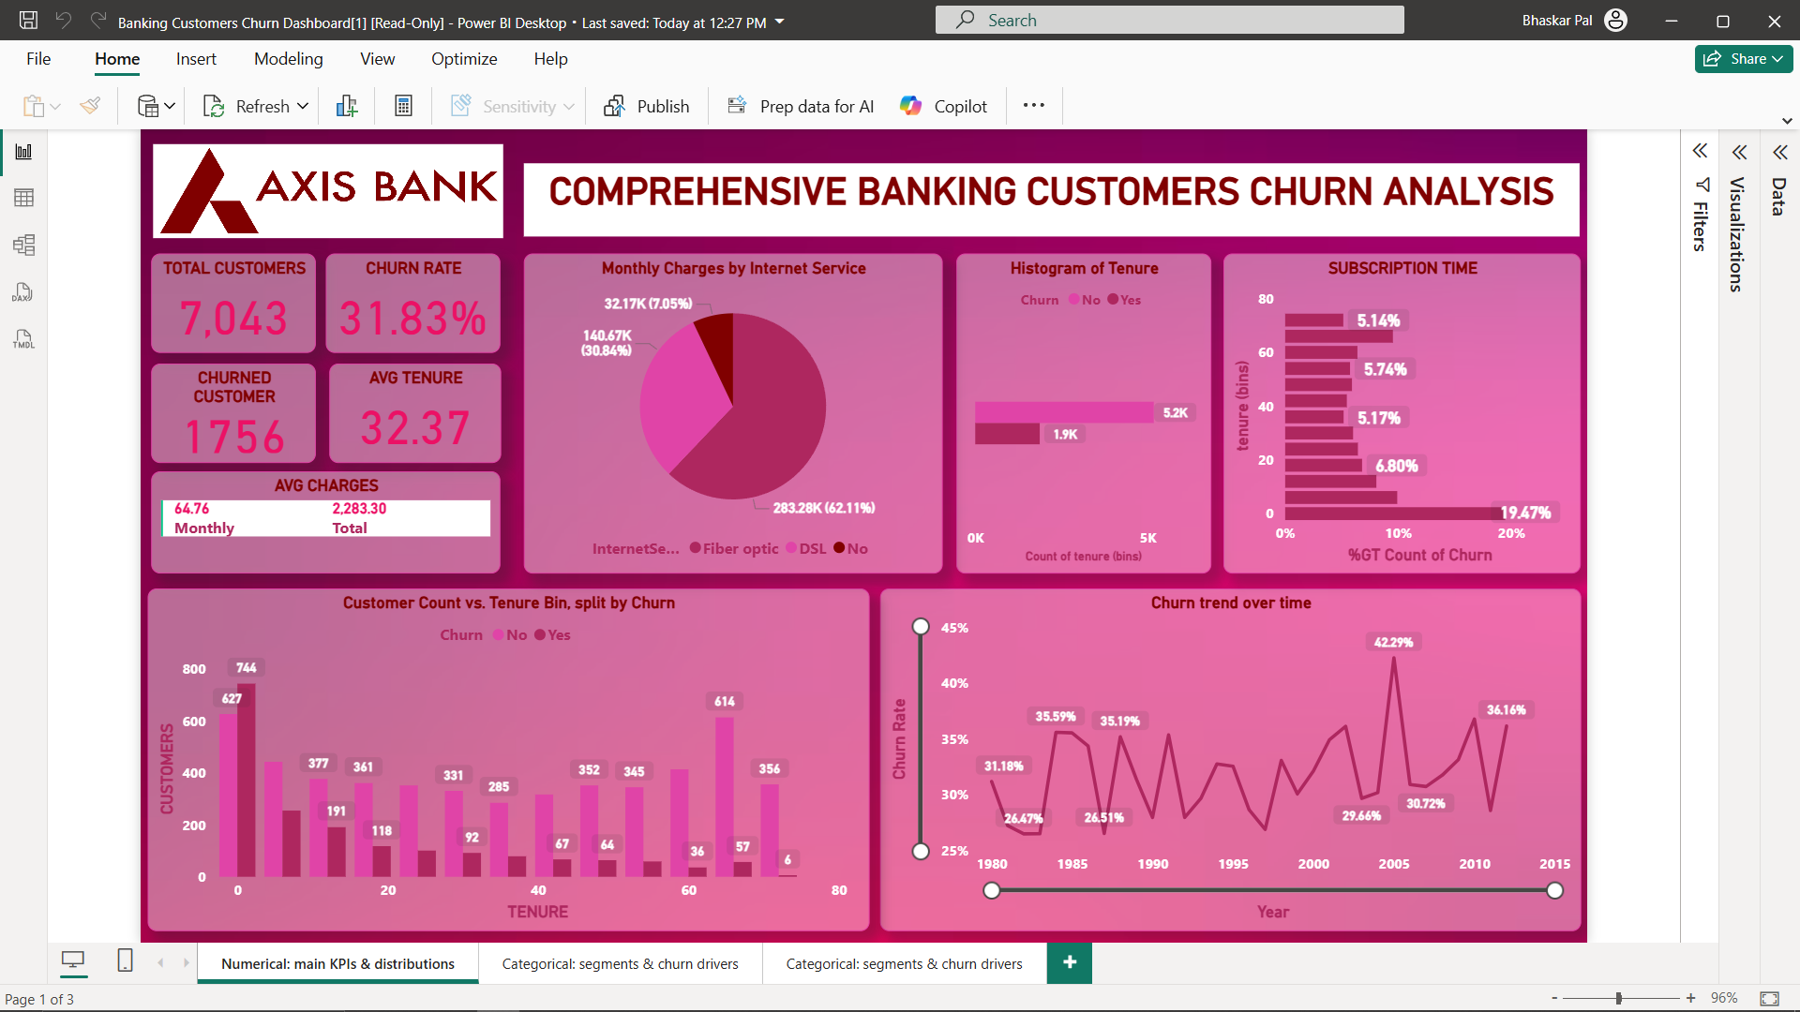
BI Dashboard (Numerical: main KPIs & distributions)

Slide 6
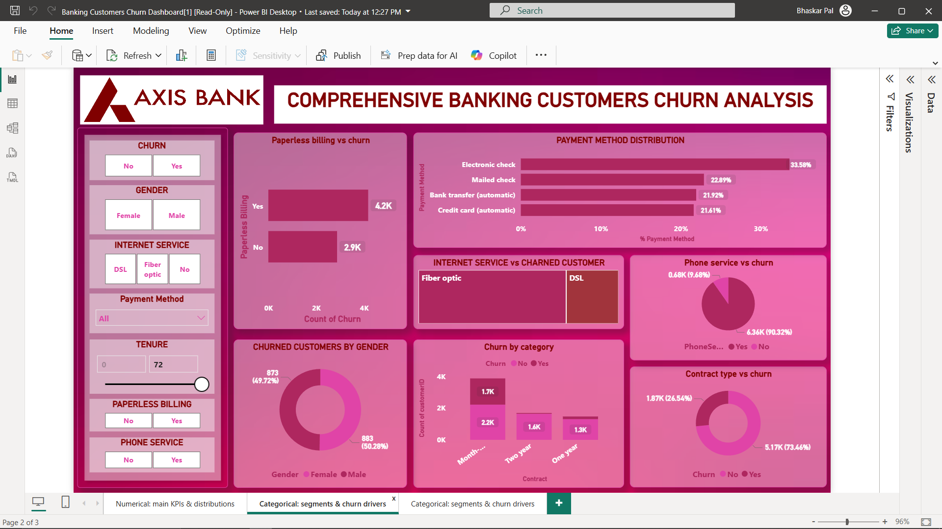
BI Dashboard (Categorical: segments & churn drivers)

Slide 7
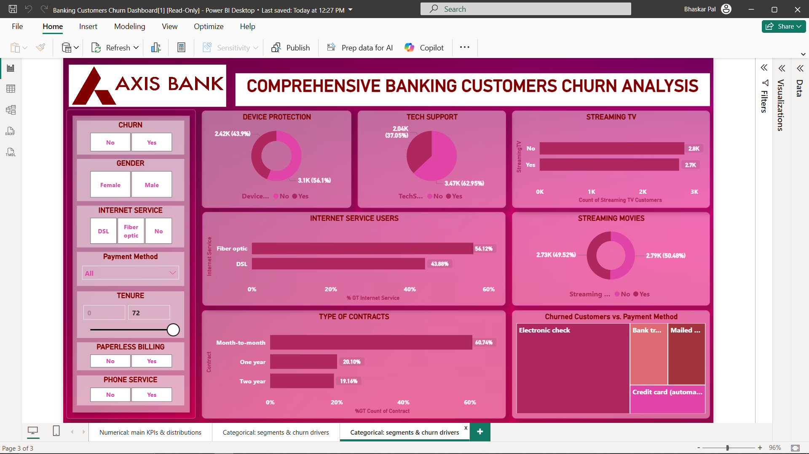
BI Dashboard (Categorical: segments & churn drivers)

Slide 8

SQL Key Insights
Overall churn rate = 26.5%.
Churned customers had higher average monthly charges.
Electronic check customers churn the most.
Short-tenure (<12 months) customers are most vulnerable.
Senior citizens have higher churn rates.
Fiber optic internet + entertainment services → higher churn.
Long-tenure customers churn significantly less.
Customers on month-to-month contracts churn the highest.

Slide 9
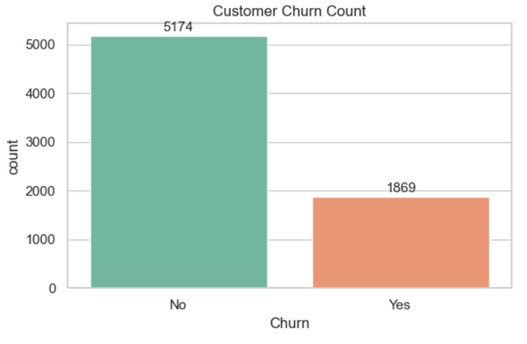
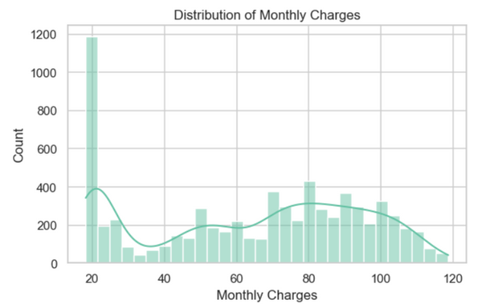
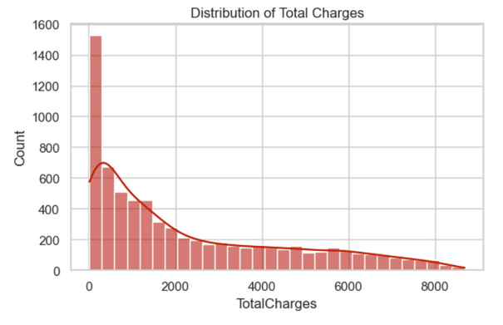
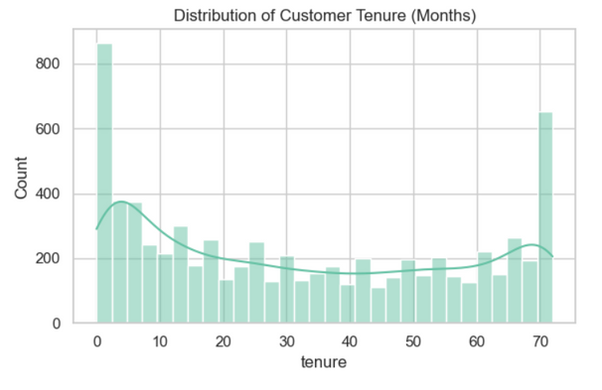
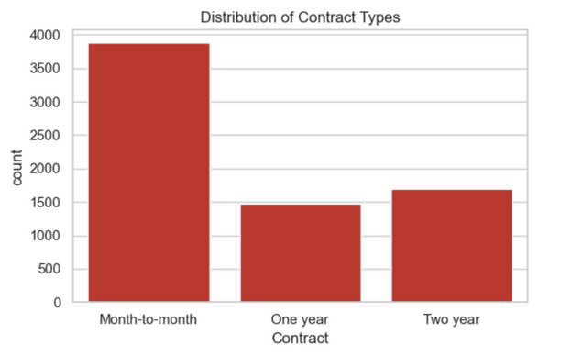
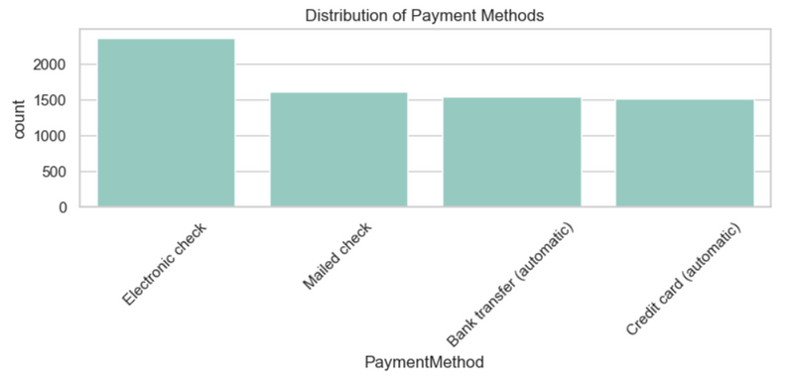
Exploratory Data Analysis (EDA)
Univariate Analysis:

Slide 10
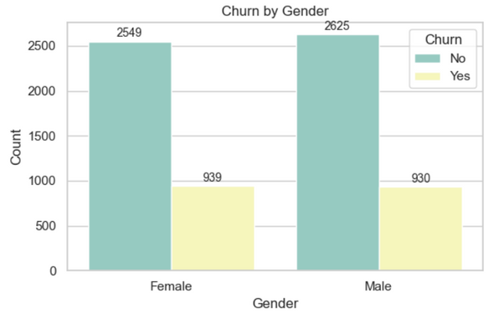
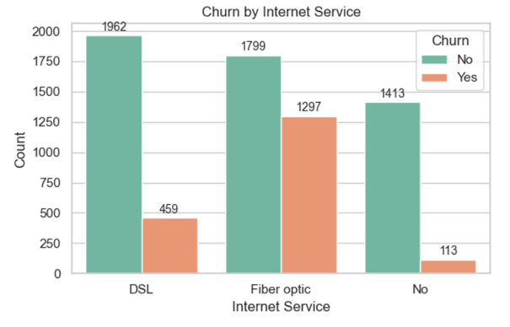
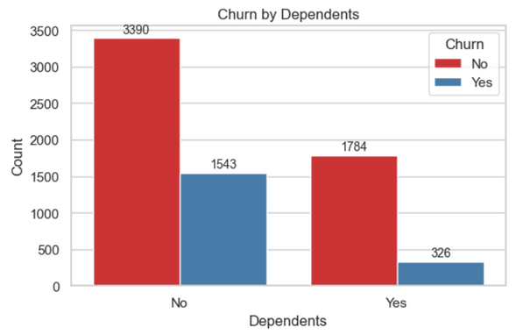
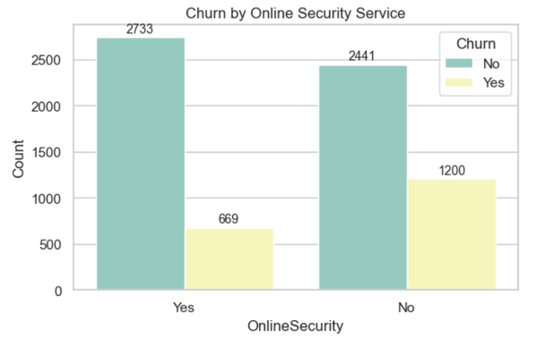
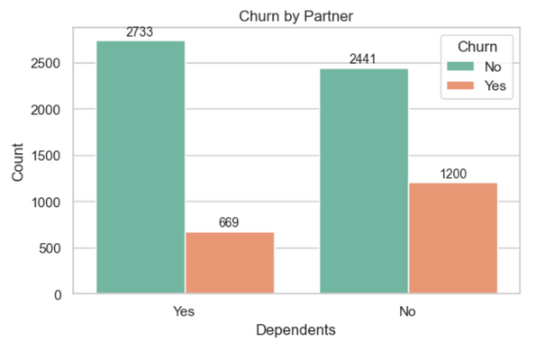
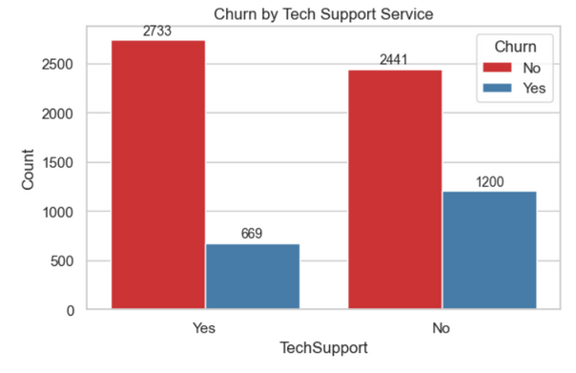
Exploratory Data Analysis (EDA)
Bivariate Analysis:

Slide 11
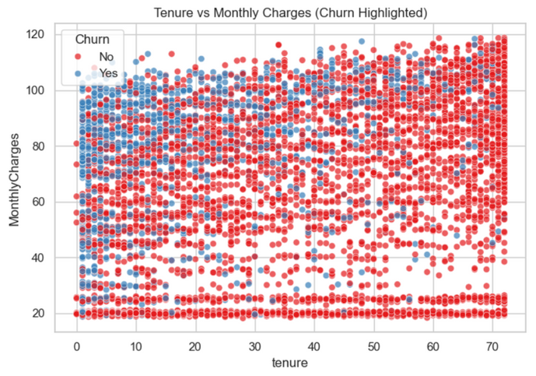
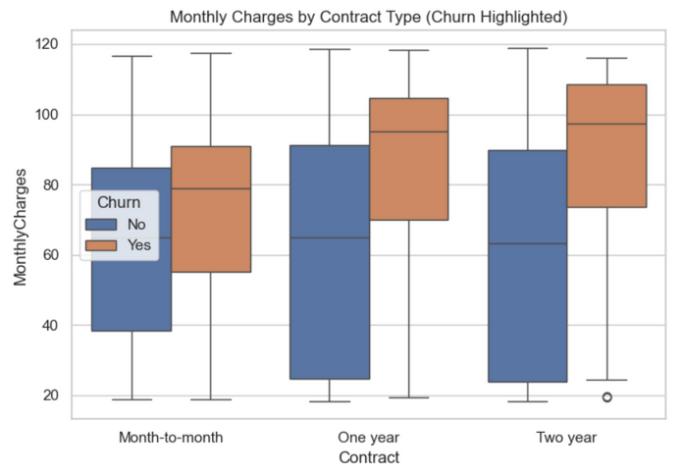
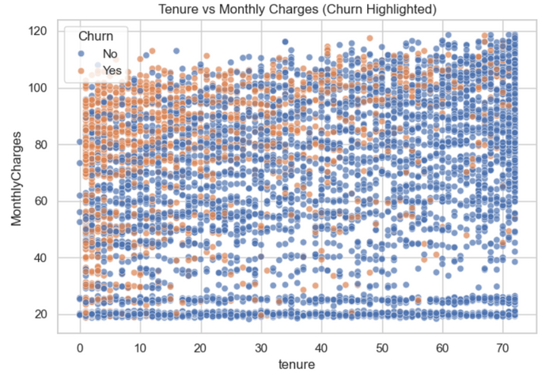
Exploratory Data Analysis (EDA)
Multivariate Analysis:

Slide 12
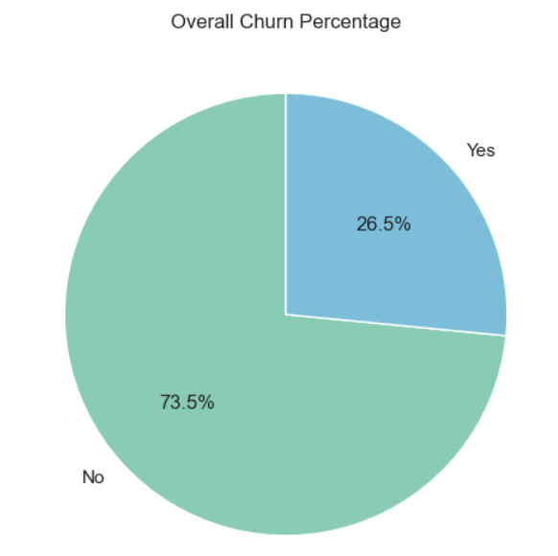
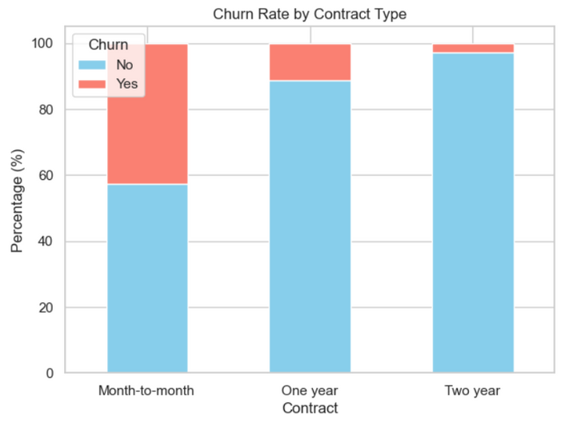
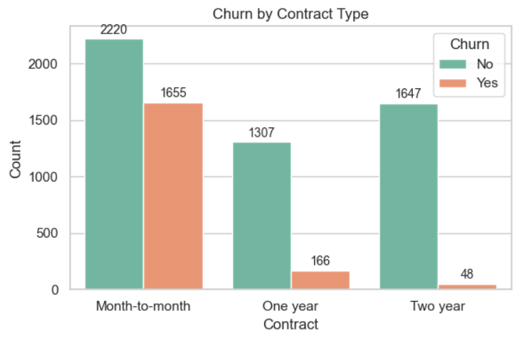
Exploratory Data Analysis (EDA)
Customer Churn Analysis:

Slide 13
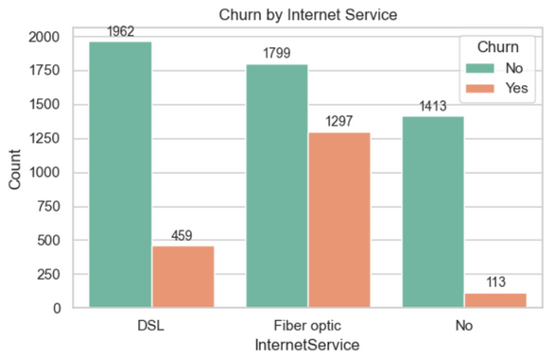
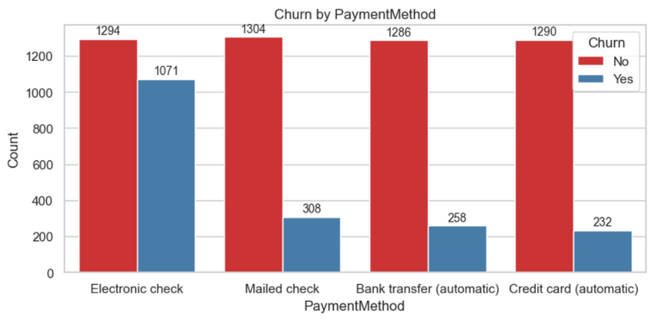
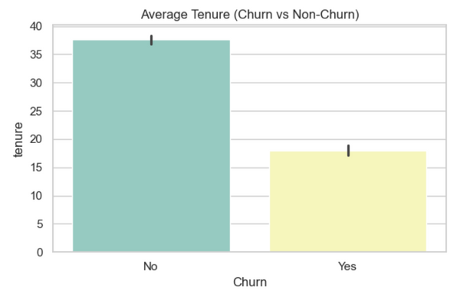
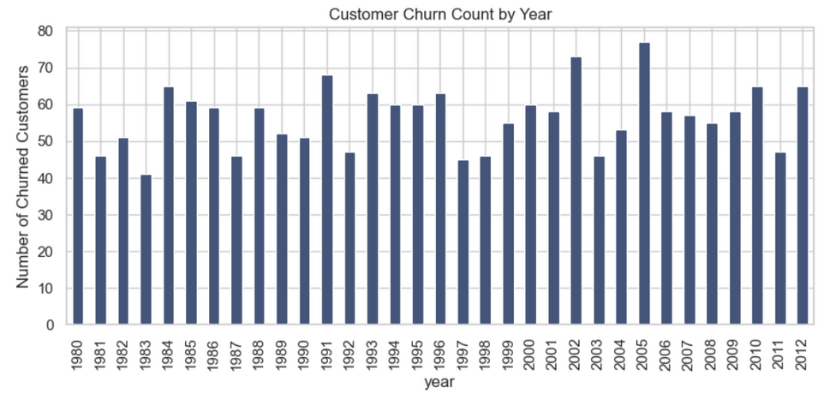
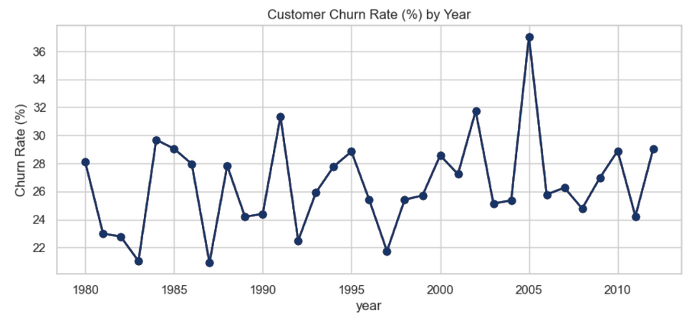
Exploratory Data Analysis (EDA)
Customer Churn Analysis:

Slide 14
Final Actionable Recommendations
Encourage customers to switch from month-to-month to yearly or two-year contracts by giving discounts or loyalty rewards.
Give more support to new customers in their first 12–18 months with welcome programs, regular check-ins, and reminders to use services.
Help customers with high monthly bills by offering bundles, loyalty credits, or discounts on extra services like security and tech support.
Ask customers to move from electronic checks to automatic payments with bank or credit cards by giving small rewards or offers.
Offer add-on services like Online Security and Tech Support because customers who use these services are less likely to leave.
Pay special attention to high-risk groups like fiber internet users, people without partners or dependents, and senior citizens with special offers and care.
Keep track of churn every week by contract type, payment method, tenure, and add-on services, and act quickly if churn starts to rise.

Slide 15
THANK YOU
“WINNING CUSTOMERS MATTERS, BUT KEEPING THEM BUILDS SUCCESS — DATA HELPS US PREVENT CHURN.”
Jayita Mondal | Abhradeep Sen | Arkaprava Ghosh | Kunal Nandi

